Slide 1
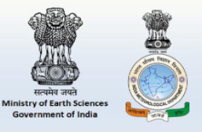
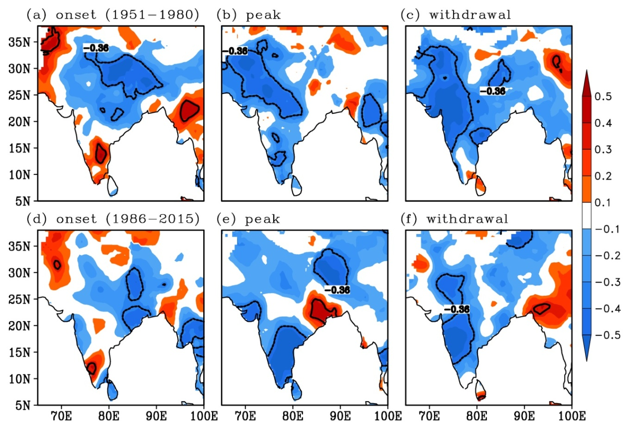
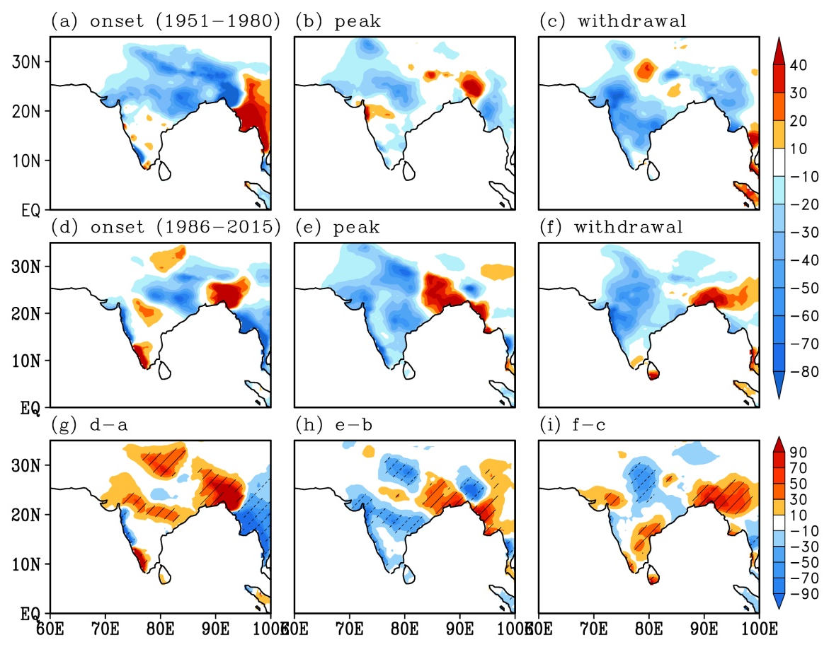
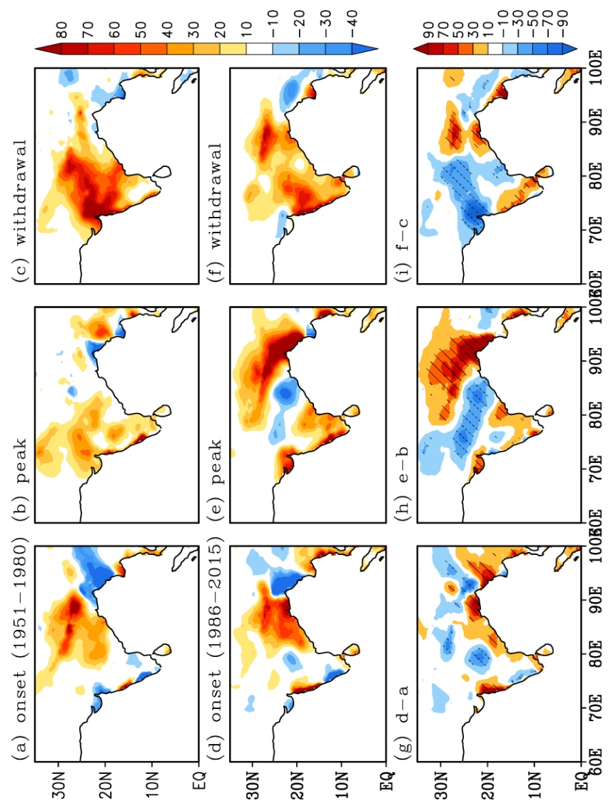
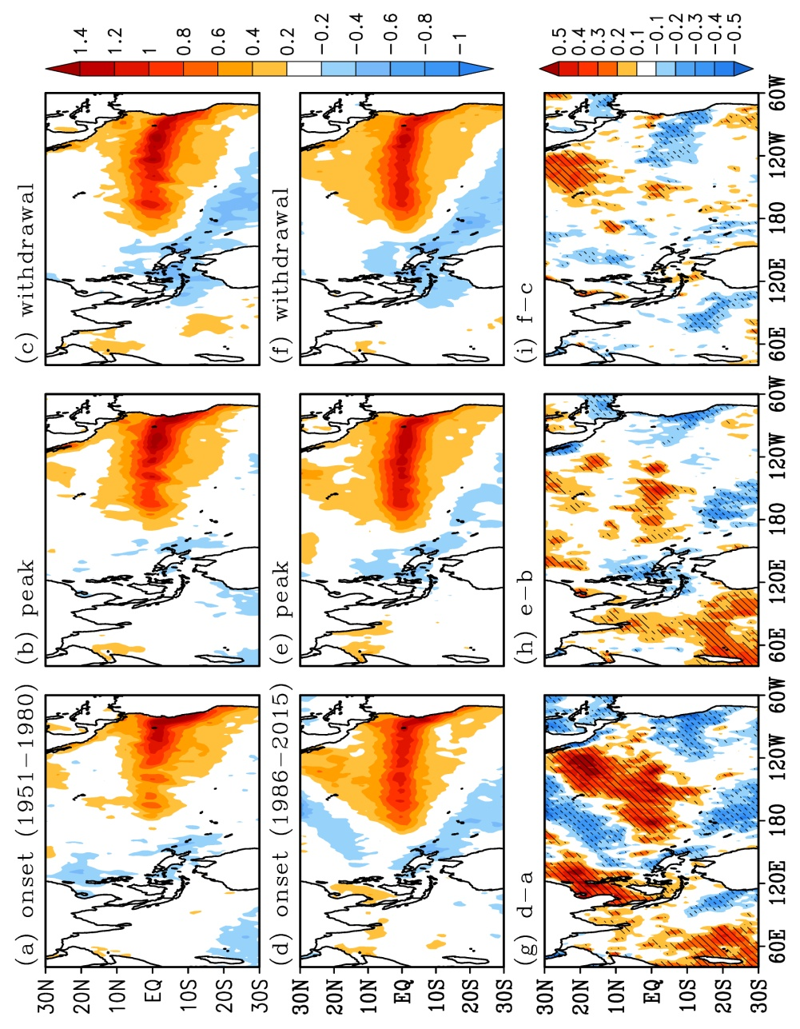
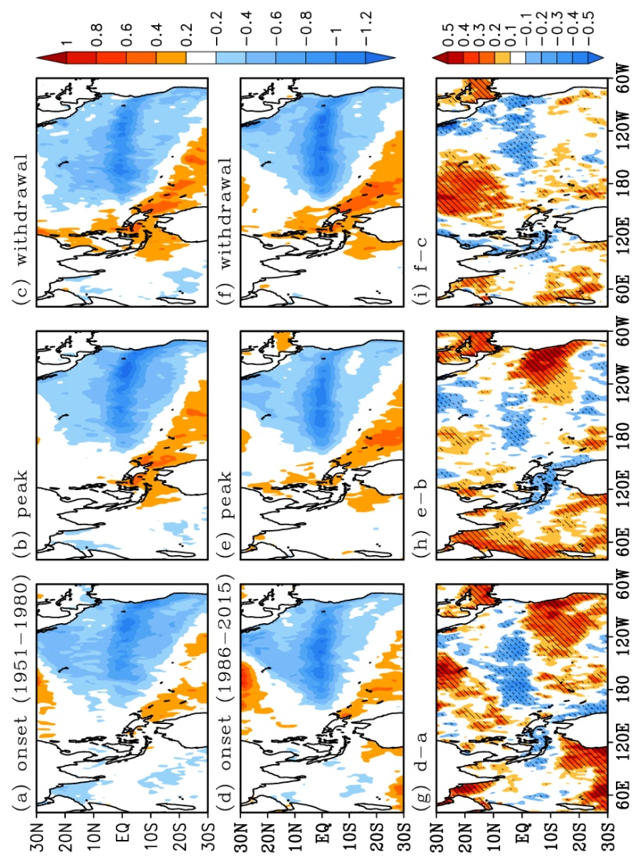
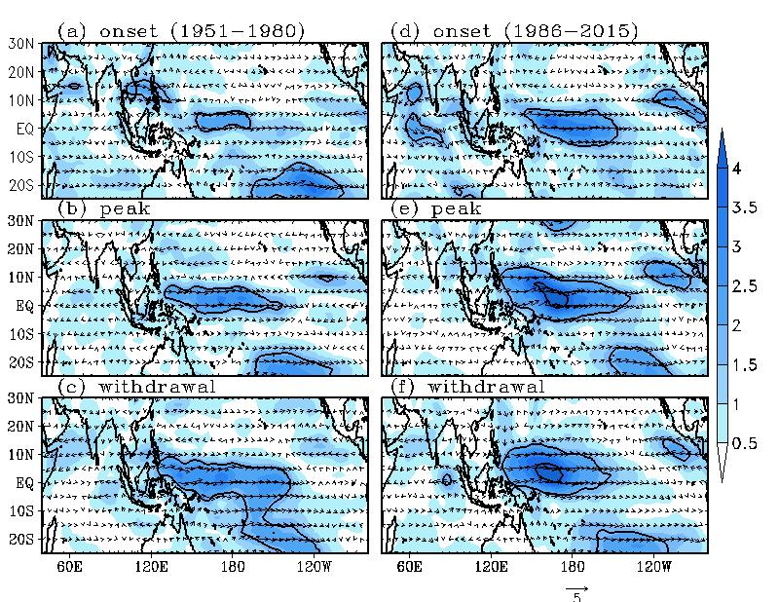
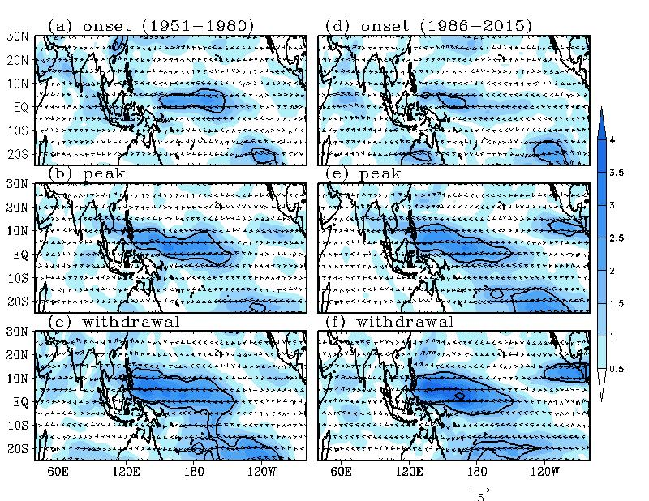
Changes in the relationship between El Niño Southern Oscillation and Indian summer monsoon rainfall from early to recent decades during different phases of monsoon
Hrudya P. H¹, Hamza Varikoden², and R. Vishnu¹
¹Dept. of Physics, Sree Krishna College, Affiliated to University of Calicut, Guruvayur, Kerala
²Indian Institute of Tropical Meteorology, Ministry of Earth Science, Pashan, Pune
Introduction
Results
Conclusions
In India, most of the annual rainfall is contributed by the Indian summer monsoon rainfall (ISMR) which exhibits high spatial and temporal variabilities. The El Niño Southern Oscillation (ENSO) is considered as one of the important external drivers of lSMR variability (Sikka 1980; Cherchi and Navarra 2013; Hrudya et al. 2020). The influence of ENSO on ISMR variability has been widely studied for the last few decades (Eg: Xavier et al. 2007; Misra et al. 2012). The ENSO and ISMR have a negative correlation over most parts of India, but weakening in recent decades (Kumar et al. 1999). Since the rainfall characteristics of different phases (onset, peak and withdrawal) of the monsoon season are different from one another, it is important to analyze their variability in relation to ENSO, separately. Identifying the changes in ENSO-ISMR relationship and its influencing mechanisms within each phase are important for better understanding and prediction of summer monsoon system.
ENSO shows significant negative correlation with ISMR during all phases in both the early and recent decades (Fig 1).
As compared to the early decades, correlation decreases in recent decades.
The ENSO-ISMR out-of-phase relationship decreases during onset, peak, and withdrawal phases in recent decades.
During El Niño years, ISMR over most of the Indian regions increases during onset phase and decreases during the other two phases. During La Niña years, a decrease in ISMR is observed over the monsoon core zone during all phases.
The changes in SST and low level circulation over the central and eastern Pacific Ocean are linked to the changes in the rainfall characteristics during all phases.
The changes are more significant during the onset phase.
Fig 1: Spatial correlation between Niño 3.4 index and ISMR in the early and recent decades during onset, peak, and withdrawal phases
Acknowledgements & References
Objectives
Acknowledgements
We are thankful to the Director, Indian Institute of Tropical Meteorology (IITM), and the Principal, Sree Krishna College, Guruvayur for providing facility for the analyses
References
Cherchi A, Navarra A (2013) Influence of ENSO and the Indian Ocean Dipole on the Indian summer monsoon variability. Clim Dyn 41: 81-103.
Hrudya PH, Varikoden H, Vishnu R (2020) A review on the Indian Summer Monsoon rainfall, Variability and their association with ENSO and IOD. Meteorol Atmos Phys: DOI: 10.1007/s00703-020-00734-5.
Kumar KK, Rajagopalan B, Cane MA (1999) On the weakening relationship between the Indian monsoon and ENSO. Science 284: 2156-2159.
Mishra V, Smoliak BV, Lettenmaier DP, Wallace JM (2012) A prominent pattern of year-to-year variability in Indian Summer Monsoon Rainfall. PNAS 109: 7213-7217.
Sikka DR (1980) Some aspects of the large scale fluctuations of summer monsoon rainfall over India in relation to fluctuations in the planetary and regional scale circulation parameters, PNAS 89: 179-195.
Xavier PK, Marzin C, Goswami BN (2007) An objective definition of the Indian summer monsoon season and a new perspective on the ENSO-monsoon relationship. Q J R Meteorol Soc133: 749-764.
To analyze the linkage between ISMR with ENSO and other drivers in the Pacific Ocean (SST, low level winds etc.) during onset, peak, and withdrawal phases of Indian summer monsoon
To analyze the changes in ENSO-ISMR relationship from early decades (1951-1980) to recent decades (1986-2015) during El Niño and La Niña events within each phases.
Fig 2: ISMR anomalies during El Niño years
Fig 3: ISMR anomalies during La Niña years
During El Niño years , there is a significant increase in ISMR during onset phase and significant decrease during peak and withdrawal phases over the monsoon core zone of India in recent decades (Fig 2).
During La Niña years, ISMR significantly decreases over the monsoon core zone during all phases. The reduction is more prominent during peak and withdrawal phases (Fig 3).
Study Area
The present work mainly focuses on the analysis of the changes in the ENSO-ISMR relations and its influencing mechanisms during different phases. The major influence for this relationship is from the Indo-Pacific domain and it affects the summer monsoon rainfall over different regions of India. Hence, the study area of the present work is the Indo-Pacific domain and the Indian region.
Fig 4: SST anomalies over the Indo-Pacific domain during El Niño years
Fig 5: SST anomalies over the Indo-Pacific domain during La Niña years
Data & Methodology
SST over the Indo-Pacific domain (mainly over the central and eastern Pacific) undergoes significant changes in recent decades during El Niño and La Niña events (Fig 4 & 5)
Easterly trade winds over the equatorial Pacific weaken in recent decades during all phases during El Niño years (Fig 6)
The reverse conditions are sustained during La Niña years (Fig 7)
The changes in circulations affect the SST over the Pacific and thus the ISMR patterns.
The changes are more noticeable during the onset phase
Data sets
Monthly data for precipitation from climate research unit (CRU) with spatial resolution of 0.5º×0.5º
NCEP/ NCAR monthly data for zonal and meridional wind components with spatial resolution of 2.5° ×2.5°
HadISST monthly data for SST with spatial resolution of 1° × 1°
Methodology
The onset, peak and withdrawal phases were selected as the months of June, July-August, and September, respectively.
The El Niño and La Niña years within the study period were classified based on Niño 3.4 index.
The early decades (1951-1980) and recent decades (1986-2015) for the analysis were selected based on a 31-year sliding correlation between ISMR and Niño 3.4 index.
Fig 6: low level wind anomalies (850 h Pa) over the Indo-Pacific domain during El Niño years
IWM-7 (22-26 March 2022)
IMD, MoES, NEW DELHI, INDIA
Fig 7: Same as Fig. 6, but for La Niña years

